Slide 1
Auto Tech Solutions: Transforming the Automotive Industry
This presentation provides an overview of the auto tech solutions that are transforming the automotive industry. It covers connectivity, automation, safety, sustainability, and future prospects. The presentation includes examples, statistics, and case studies to support the points discussed.

Slide 2
Introduction
In a world where technology is at the forefront of transformation, AutoTech Solutions emerges as a game-changer in the automotive industry. We're on a mission to seamlessly blend cutting-edge Information Technology (IT) innovations with the automotive landscape, recognizing the rising importance of IT in modern vehicles. Our vision is to redefine the driving experience, elevating vehicle performance, safety, and user engagement through state-of-the-art telematics, robust cybersecurity, data-driven predictive maintenance, and flawless connectivity.
Moreover, our unwavering commitment to eco-friendliness ensures we tread lightly on the environment. The automotive sector is evolving at an unprecedented pace, and AutoTech Solutions is poised to lead this change, setting new industry benchmarks as we go.

Slide 3

The Automotive Industry Today
Rapid Technological Evolution: Staying abreast of the ever-evolving technology landscape is a pressing challenge. Integrating the latest advancements like AI, IoT, and cybersecurity into vehicles while ensuring compatibility and reliability is vital.
Growing Demand for Smart Vehicles: As consumers increasingly seek vehicles with advanced connectivity, autonomous features, and predictive maintenance, the automotive market is shifting towards smart, tech-enabled solutions.

Slide 4

Our Solutions
Telematics Integration: Real-time data analysis for enhanced vehicle performance, predictive maintenance, and safety.
Cybersecurity Measures: Robust solutions to protect vehicles from cyber threats.
Predictive Maintenance: AI-driven maintenance insights for reduced downtime and costs.
Eco-Friendly Initiatives: Optimize fuel efficiency and minimize environmental impact.

Slide 5
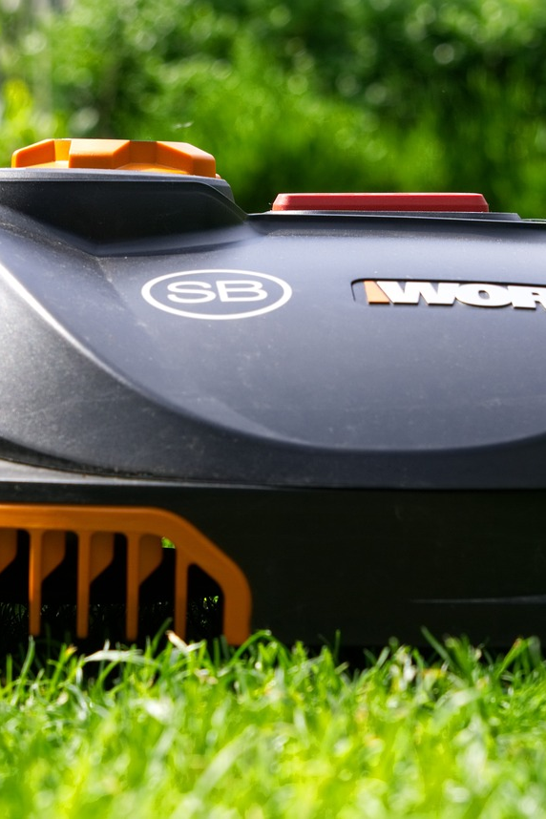
Softwares Used
Python: We used Python as our primary programming language for data analysis and machine learning.
Scikit-Learn: Scikit-Learn, a powerful machine learning library, aided in model development.
Pandas: We utilized Pandas for data manipulation and preprocessing.
Django: Django served as our robust backend framework, facilitating seamless integration of machine learning models.
HTML, CSS, JavaScript: For the frontend, we used a combination of HTML, CSS, and JavaScript to build an interactive user interface.
Jupyter Notebook: Jupyter Notebook was our integrated development environment (IDE) for coding and analysis.

Slide 6
implementation
Utilizing Data for Accurate Predictions
Improving Efficiency and Accuracy
We have successfully implemented machine learning models that utilize various data points, including the year, selling price, and kilometers driven, to accurately predict maintenance needed. By analyzing these factors, the models can provide valuable insights into how long maintenance tasks are expected to take.
Through the implementation of these machine learning models, we aim to improve the efficiency and accuracy of maintenance needed predictions. By leveraging the power of data and advanced algorithms, we can make more informed decisions and optimize resource allocation for maintenance tasks.

Slide 7
Conclusion: Auto Tech Solutions Driving the Future
A Transformation in the Automotive Industry
Commitment to Sustainability
Auto tech solutions are driving a major transformation in the automotive industry, bringing advancements in efficiency, safety, and sustainability. Connectivity, automation, electrification, and safety innovations are revolutionizing the driving experience.
Sustainability remains a top priority for the industry, with a strong commitment to reducing environmental impact. Auto tech solutions play a crucial role in achieving this goal by promoting cleaner and greener transportation options.

Slide 8
Future Prospects of Auto Tech Solutions
The future also holds numerous opportunities for research, development, and investment in Auto Tech. As the industry continues to evolve, there will be a growing demand for skilled professionals and innovative solutions. Auto Tech Solutions has the potential to shape the future of mobility and contribute to a more sustainable and connected world.
The future of Auto Tech Solutions is incredibly promising. Continued advancements in autonomous driving will redefine transportation, improving efficiency and safety. Electrification is set to become mainstream, with electric vehicles (EVs) dominating the market. Innovations in connectivity will make vehicles more integrated into daily life.
Embracing sustainability and reducing emissions will remain a top priority. As the world shifts towards a greener future, Auto Tech Solutions will play a crucial role in developing eco-friendly technologies. This includes the adoption of renewable energy sources and the implementation of energy-efficient systems in vehicles.

Slide 9
References
Reach out to me
Leveraged Mock data from Keagle to create data.
Name: Arjun K M
E Mail: arjun.k2020@vitstudent.ac.in
My Site: Arjun K M | Portfolio (arjunronit.github.io)

Slide 10
Thank you for your time and attention 🙂

